Slide 1
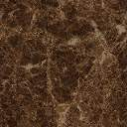
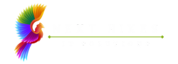
NEXTHIKE IT SOLUTIONS
Medical Report OCR using YOLO & Tesseract
Mr. Aniket G. Tayade.

Slide 2
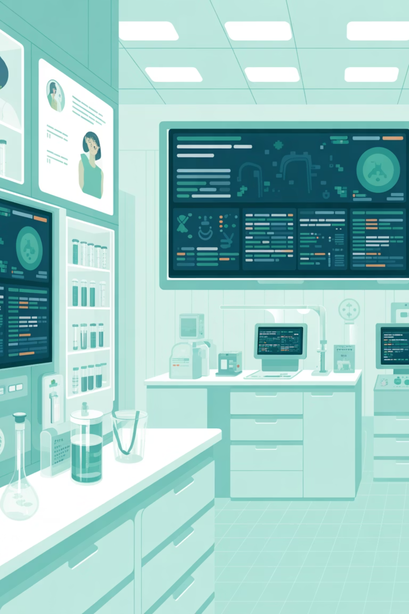
Medical Report OCR using YOLO & Tesseract
A custom OCR system designed specifically for automated extraction of structured data from medical laboratory reports. This solution combines state-of-the-art YOLO-based text detection with Tesseract optical character recognition to transform unstructured medical documents into actionable, machine-readable data.
Author: Aniket Tayade

Slide 3

PROBLEM STATEMENT
The Challenge in Medical Data Processing
Current State
Key Pain Points
Medical laboratories generate thousands of reports daily, but most exist as unstructured, non-editable documents—typically scanned PDFs or paper forms that cannot be directly integrated into digital health systems.
Manual data entry consumes significant staff time and introduces human error into critical health records
Inconsistent formats across different labs make standardization nearly impossible
Delayed processing impacts patient care timelines and clinical decision-making
Limited searchability prevents efficient data retrieval and analysis
Our Goal: Develop an automated system that accurately extracts structured data from medical lab reports, eliminating manual transcription while maintaining high accuracy standards required in healthcare environments.

Slide 4
Proposed Solution Architecture
Our approach leverages a multi-stage pipeline that combines computer vision and optical character recognition to transform unstructured medical reports into structured, machine-readable formats.
01
02
03
Text Region Detection
Intelligent Cropping
Image Preprocessing
YOLO (You Only Look Once) neural network identifies and localizes all text regions within the medical report image, creating bounding boxes around relevant data fields.
Detected regions are precisely cropped from the source image, isolating individual data fields for focused OCR processing.
Advanced image enhancement techniques optimize each cropped region—adjusting contrast, reducing noise, and improving text clarity for maximum OCR accuracy.
04
05
Text Extraction
Structured Output
Tesseract OCR engine processes the enhanced images, converting visual text into digital strings with high accuracy.
Extracted text is organized into standardized formats (CSV/JSON), ready for integration with electronic health record systems and downstream analytics pipelines.

Slide 5
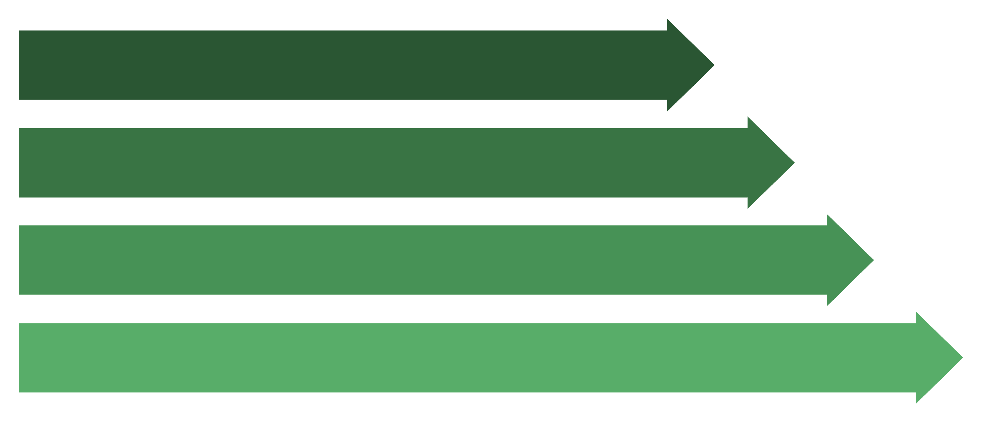

System Architecture Pipeline
The end-to-end processing flow demonstrates how raw medical report images are transformed into structured data through our integrated detection and recognition pipeline.
Input Image
YOLO Detection
Region Cropping
Preprocessing
This architecture ensures scalability and reliability while maintaining the processing speed necessary for high-volume clinical environments. Each stage is optimized for medical document characteristics, including varying image quality, diverse layout structures, and domain-specific terminology.
Performance Note: The modular design allows for parallel processing of multiple regions, significantly reducing overall processing time for complex multi-page reports.

Slide 6
Dataset Creation & Annotation Strategy
Building a robust OCR system requires carefully curated training data that represents the diversity of real-world medical reports. Our dataset encompasses various lab report formats, quality levels, and layout structures.
Custom Medical Dataset
YOLO-Format Annotations
Data Partitioning
Cloud Storage
Strategic split: 70% training, 20% validation, 10% test set to ensure model generalization across unseen report formats.
Dataset securely stored on Google Drive and AWS S3 with version control, enabling collaborative development and reproducible experiments.
Collected diverse laboratory reports including blood work, urinalysis, metabolic panels, and diagnostic imaging results from multiple healthcare facilities.
Each text region manually labeled with bounding box coordinates and class labels (patient info, test name, result value, reference range).
Annotation quality directly impacts model performance—each report underwent multiple review cycles to ensure bounding box accuracy and class label correctness, critical for healthcare applications where precision is non-negotiable.

Slide 7






DEEP LEARNING
YOLO Model Configuration
Model Architecture
We evaluated both YOLOv3 and YOLOv8 architectures for text detection, ultimately selecting the version that best balances accuracy and inference speed for our specific use case.
YOLO's single-stage detection approach provides real-time performance while maintaining high accuracy—essential for processing large volumes of reports in clinical workflows.
Training Strategy
Custom-trained weights initialized from COCO-pretrained models
Fine-tuned on medical report dataset with data augmentation
Optimized anchor boxes for typical text region aspect ratios
Patient Information
Test Names
Result Values
Reference Ranges
Name, ID, demographics
Laboratory test identifiers
Numeric test outcomes
Normal value boundaries

Slide 8



OCR Preprocessing Pipeline
Image quality significantly impacts OCR accuracy. Our preprocessing pipeline applies multiple enhancement techniques to optimize text recognition, especially for low-quality scans or photos common in healthcare settings.
Grayscale Conversion
CLAHE Enhancement
Denoising & Thresholding
Reduces color complexity while preserving text information, improving OCR focus on character shapes rather than chromatic variations.
Contrast Limited Adaptive Histogram Equalization enhances local contrast, making faded or poorly scanned text more readable without amplifying noise.
Removes artifacts and background noise, then applies binary thresholding to create crisp black-and-white text ideal for character recognition.
These preprocessing steps collectively improve OCR accuracy by 15-25% compared to processing raw images directly, particularly valuable when handling reports with varying scan quality, lighting conditions, or paper degradation.

Slide 9


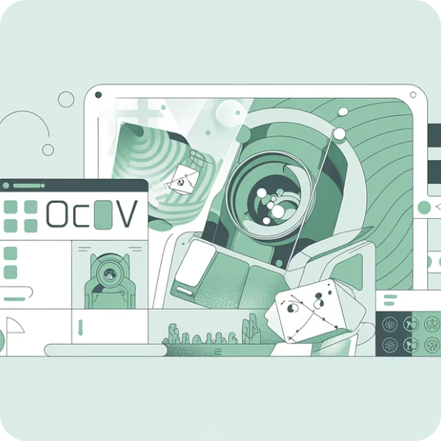

Infrastructure & Technology Stack
Our implementation leverages cloud computing resources and open-source tools to create a scalable, cost-effective OCR pipeline suitable for both research and production deployment.
Google Colab
AWS Services
Computer Vision Libraries
Free GPU acceleration for model training and inference during development. Jupyter notebook environment enables rapid prototyping and experimentation without infrastructure costs.
Production-ready cloud infrastructure with S3 for scalable dataset storage and SageMaker for managed model training and deployment at enterprise scale.
OpenCV handles image manipulation and preprocessing. Tesseract OCR (via PyTesseract wrapper) provides battle-tested text recognition with medical terminology support.
Deployment Flexibility: The system can run on local machines for pilot testing or scale to cloud infrastructure for production workloads, supporting various organizational IT environments and budget constraints.

Slide 10

RESULTS
Extraction Results & Output Formats
The system successfully extracts key information from medical lab reports and structures it into multiple formats for seamless integration with downstream healthcare IT systems.
Extracted Data Categories
Output Formats
Patient Demographics
CSV Files: Tabular format for spreadsheet analysis and database import, with each row representing a test result.
Name, medical record number, date of birth, gender, and contact information extracted from report headers.
JSON Documents: Structured hierarchical format preserving relationships between patient info, tests, and results—ideal for API integration.
Test Results
Processing Logs: Detailed execution records including confidence scores, processing times, and error reports for quality assurance.
Laboratory test names paired with corresponding values, units of measurement, and flags for abnormal results.
Reference Ranges
Normal value ranges for each test, enabling automated flagging of out-of-range results for clinical review.
All outputs maintain HIPAA-compliant data handling practices and can be directly ingested into electronic health record systems, laboratory information management systems, or data warehouses for analytics.

Slide 11
Conclusion & Future Development
We've successfully developed an automated OCR pipeline that transforms unstructured medical laboratory reports into structured, machine-readable data with high accuracy. This system addresses critical pain points in healthcare data management while maintaining the precision standards required for clinical applications.
Proven Accuracy
Hospital-Scale Deployment
Time Savings
Achieves reliable text extraction across diverse report formats with minimal manual intervention required.
Architecture designed for scalability—can process thousands of reports daily in production healthcare environments.
Eliminates hours of manual data entry, allowing clinical staff to focus on patient care rather than transcription.
Future Enhancements
Advanced Layout Models: Integrate document layout analysis (LayoutLM, Donut) for better understanding of complex multi-column reports
NLP Integration: Add natural language processing to extract clinical insights and relationships between test results
Interactive Dashboard: Build web-based UI for report upload, real-time processing monitoring, and result verification
Multi-language Support: Extend OCR capabilities to handle reports in languages beyond English

Slide 12

Thank you so much for taking the time to review my presentation. I truly appreciate your support!

